Slide 1

Detection of Hate and Threat in Digital Forensics: A Case-Driven Multimodal Approach
Ponkoj Chandra Shill PhD Candidate Computer Science and Engineering University of Nevada, Reno
Presenting Research Work to Joshua Watson Digital Forensic Examiner Course: CS 704 Digital Forensics

Slide 2
The Real problem
Digital forensic evidence is heterogeneous Images, screenshots, and reports may contain embedded text, associated text, or no text at all
Existing detection systems make strong assumptions Text-only approaches ignore visual evidence, while multimodal models assume all modalities are always present
Forensic analysis demands justification Conclusions must be traceable to the specific evidence used, not just high-confidence predictions

Slide 3
Why this matters for digital forensics
Evidence must drive analysis Forensic workflows require that only analyses justified by available evidence are performed
Decisions must be traceable and auditable Investigators need to know which modality contributed to a decision and how
Systems must handle missing or partial data Real cases often lack complete modalities, and pipelines must degrade gracefully

Slide 4
core idea
Case-driven multimodal reasoning First determine what evidence exists: embedded text, associated text, or image only
Evidence-justified analysis Run only the analyses supported by the available evidence, instead of assuming all modalities
Case-aware evaluation (DS1–DS4) Performance is evaluated separately across four data situations because evidence availability changes the task
Measuring the impact of fusion We quantify how often multimodal fusion changes the decision compared to image-only inference

Slide 5
Related Works
Text-only and multimodal detection models Effective for moderation tasks, but assume fixed or complete input modalities
Multimodal fusion approaches Combine image and text features without explicitly reasoning about evidence availability
Digital forensics practice Emphasizes traceability and justification, which most ML pipelines do not explicitly support

Slide 6
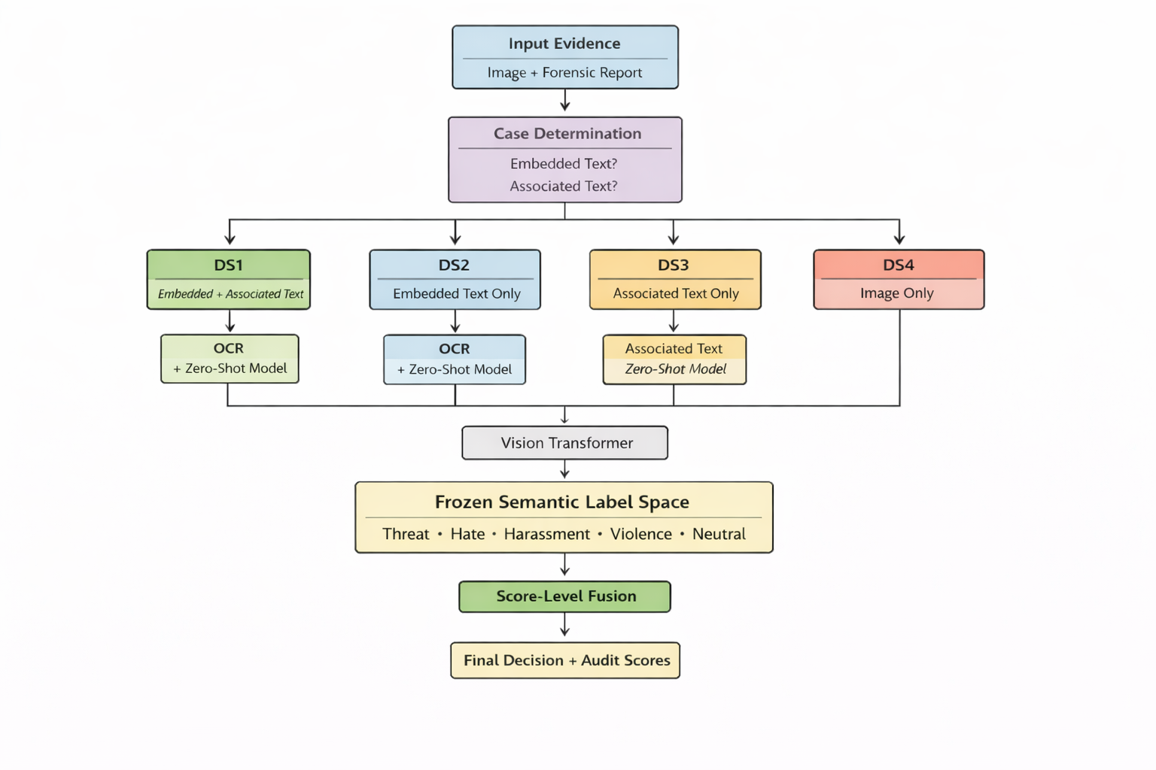
Methodology

Slide 7
Experimental Setup
Type of evidence used
Heterogeneous forensic-style evidence
Images, OCR-derived embedded text, and associated contextual text
Learning setting
Zero-shot inference only
No task-specific training or fine-tuning
Models used
Image analysis: CLIP-based vision–language model (ViT-L/14)
Text analysis: Transformer-based zero-shot classifier (DeBERTa-v3-large–based)

Slide 8
Case-driven routing
Three forensic checks Embedded text detection, associated text availability, and image-only evidence
Four derived data situations (DS1–DS4) Evidence is routed based on which text sources are present
Deterministic, evidence-first logic Routing follows explicit true/false decisions, not learned assumptions

Slide 9
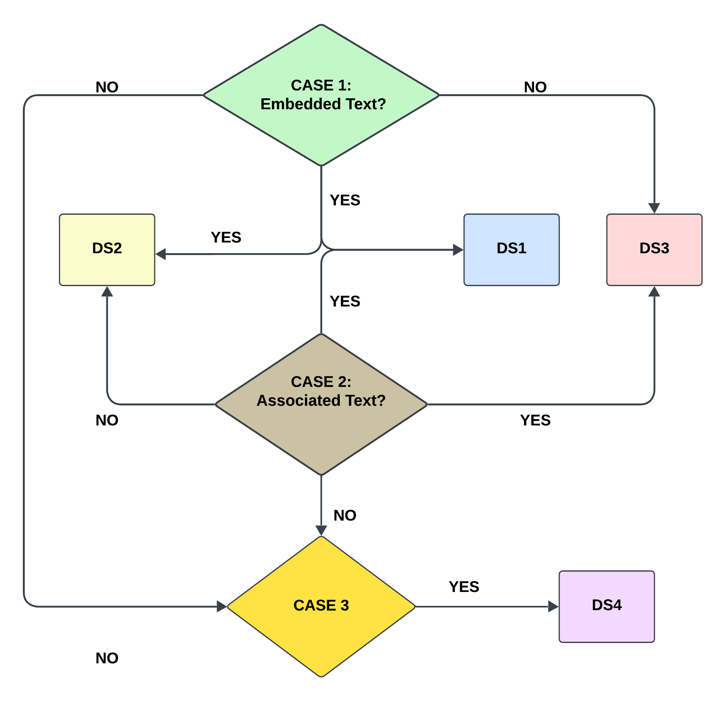
Modality

Slide 10
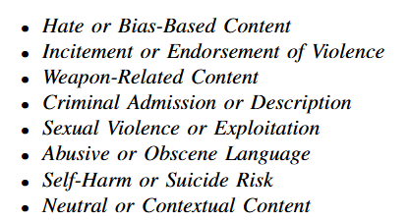
Frozen label space
Single, fixed forensic label set All modalities map into the same predefined semantic categories
Prevents label drift across models Image, OCR text, and associated text use identical label definitions
Enables interpretable fusion Scores can be compared and combined meaningfully across modalities

Slide 11
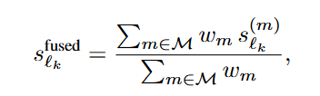
Fusion
Fusion only when multiple modalities exist Image, OCR text, and associated text are combined only if present
Fixed, evidence-driven weights Image: 1.0, OCR text: 1.0, Associated text: 1.2 Missing modalities are excluded rather than penalized
Audit-friendly outputs Per-modality scores and fused scores are retained

Slide 12
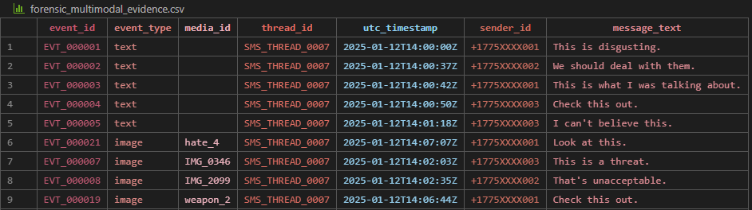

Example Walkthrough (weapon_2)

Slide 13
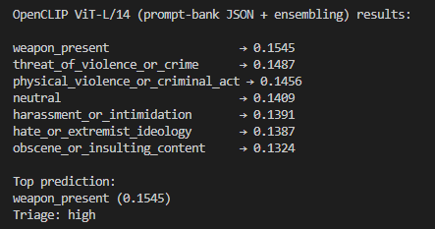
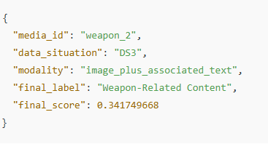
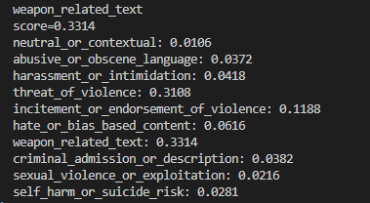
Example Walkthrough (weapon_2)

Slide 14
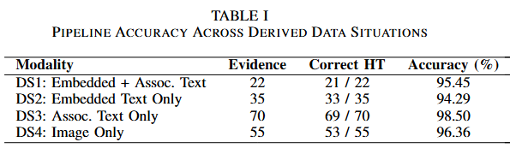
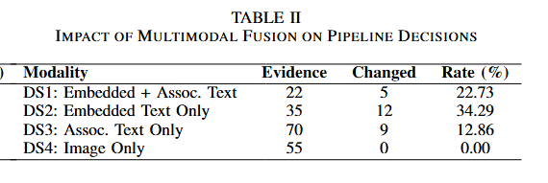
Results
Stable performance across evidence conditions (DS1–DS4) High accuracy is maintained whether evidence includes embedded text, associated text, or image-only content (Table I)
Multimodal fusion changes decisions when text is present In DS1–DS3, fusion alters the final label in a substantial fraction of cases, showing that textual context materially influences interpretation (Table II)

Slide 15
Discussion and Conclusion
Evidence-aware multimodal reasoning The pipeline conditions analysis on what evidence actually exists, aligning automated inference with forensic practice
Transparent and auditable decisions Case-driven routing, a frozen label space, and score-level fusion preserve traceability and interpretability
Effective across heterogeneous forensic scenarios Results show consistent performance across DS1–DS4 and meaningful impact of multimodal fusion when text is available
Designed for decision support, not replacement The system supports forensic triage and analyst review rather than fully automated judgment

Slide 16
REFERENCES
[1] J. Devlin, M.-W. Chang, K. Lee, and K. Toutanova, “Bert: Pre-training ofdeep bidirectional transformers for language understanding,” in NAACLHLT, 2019.
[2] A. Radford, J. W. Kim, C. Hallacy et al., “Learning transferable visualmodels from natural language supervision,” in ICML, 2021.
[3] D. Kiela, H. Firooz, A. Mohan, V. Goswami, A. Singh, D. Fitzpatrick,and J. Turian, “The hateful memes challenge: Detecting hate speechin multimodal memes,” in Advances in Neural Information ProcessingSystems (NeurIPS), 2020.
[4] R. Gomez et al., “Exploring hate speech detection in multimodalpublications,” in IEEE Winter Conference on Applications of ComputerVision (WACV), 2020.
[5] F. T. Boishakhi, P. C. Shill, and M. G. R. Alam, “Multi-modal hatespeech detection using machine learning,” in 2021 IEEE InternationalConference on Big Data (BigData), 2021.
[6] T. Baltruˇsaitis, C. Ahuja, and L.-P. Morency, “Multimodal machinelearning: A survey and taxonomy,” IEEE Transactions on PatternAnalysis and Machine Intelligence, vol. 41, p. 423–443, 2018.
[7] A. Arya et al., “Multimodal hate speech detection in memes usingcontrastive language-image pre-training,” IEEE Access, 2024.
[8] Y. Zhu et al., “Multimodal zero-shot hateful meme detection,” WebSci’22: Proceedings of the 14th ACM Web Science Conference 2022, 2022.
[9] J. Yamagishi, “Simpler prompts, better results: Enhancing zero-shot de-tection with a large multimodal model,” in ACL Workshop Proceedings,2024.
[10] Z. Kuˇcerov´a et al., “Machine learning for crime report classification,”IEEE Access, 2020.
[11] G. Karystianis et al., “Automated information extraction from policereports,” Journal of Biomedical Informatics, 2018.
[12] X. Du et al., “Deep learning for digital forensics: A survey,” ForensicScience International: Digital Investigation, 2020.

Slide 17
Thank You
An open-source implementation of the proposed framework is available at https://github.com/CS-Ponkoj/Hate-and-Threat-Detection-in-Forensics

